Slide 1

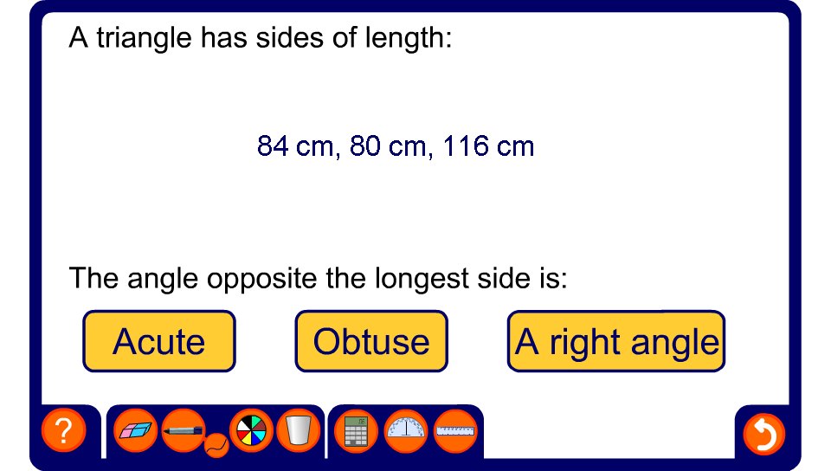


Obtuse, acute or right-angled triangle
Notes:
In this activity pupils must find the sum of the squares of the two shorter sides. If this is less than the square of the longest side, the angle opposite the longest side must be acute. If this is more than the square of the longest side, the angle opposite the longest side must be obtuse.
If this is the same as the square of the longest side, the triangle obeys Pythagoras’ Theorem and the angle opposite the longest side must therefore be a right angle.
Pupils may use their calculators for lengths involving decimals.

